Slide 1
Hello Elixir!
Sameeri Marryboyina

Slide 2




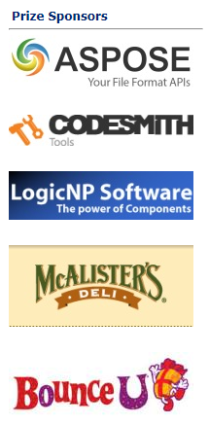


Thank you sponsors

Slide 4
About me
Sameeri Pavan Kumar Marryboyina
Hyderabad, India
I can communicate in Telugu, Hindi, English, German(very little)
MS in Computer Science, The University of Oklahoma
Senior Software Engineer, Telogical Systems LLC
Full Stack JS - React, Redux and its Ecosystem, Node, Express
Norman, OK

Slide 5
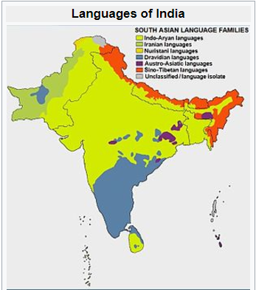
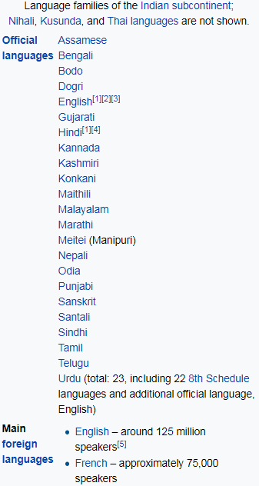
source : https://en.wikipedia.org/wiki/Languages_of_India

Slide 6
Being a polyglot...
WORK | SCHOOL | LEARNING | RADAR
JavaScript | C | Elixir | Elm
C# | C++/VC++ | Erlang | TypeScript
Ruby | COBOL |  | Python
Java | Assembly |  | Scala
 |  |  | Rust
 |  |  | Go

Slide 7

But, What does it mean to be a Language?

Slide 8
What kind of a problem are we trying to solve?
A language is a tool.
Problems and Contexts
We want to use the right tool for a given problem
Communication

Slide 9
A Language…
Alphabet
Constructs
Syntax
Semantics
Type System (Static vs Dynamic)
Translation Model (Compiled vs Interpreted)
Execution model
Runtime Mechanics
Specification
Implementation

Slide 10
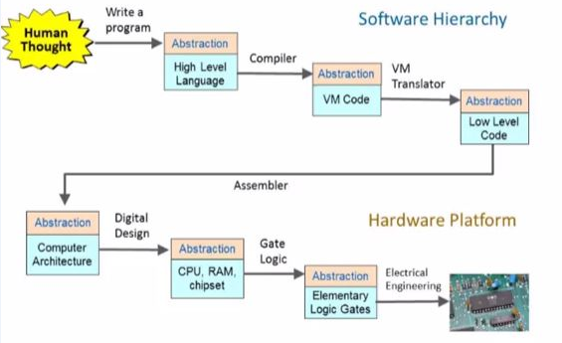
The process – From Human thought to something magical
source : http://www.nand2tetris.org/

Slide 11
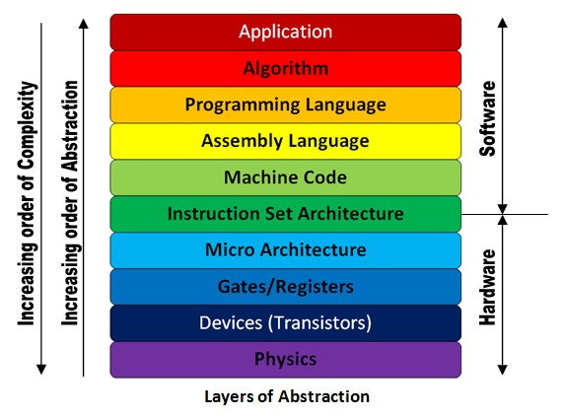
The Machine stack – Layers of Abstraction
source : http://theembeddedguy.com/2016/05/15/layers-of-abstraction/

Slide 12
Language translation
TRANSLATOR
SOURCE
LANGUAGE
TARGET LANGUAGE

Slide 13
Virtual Machine

